Slide 1
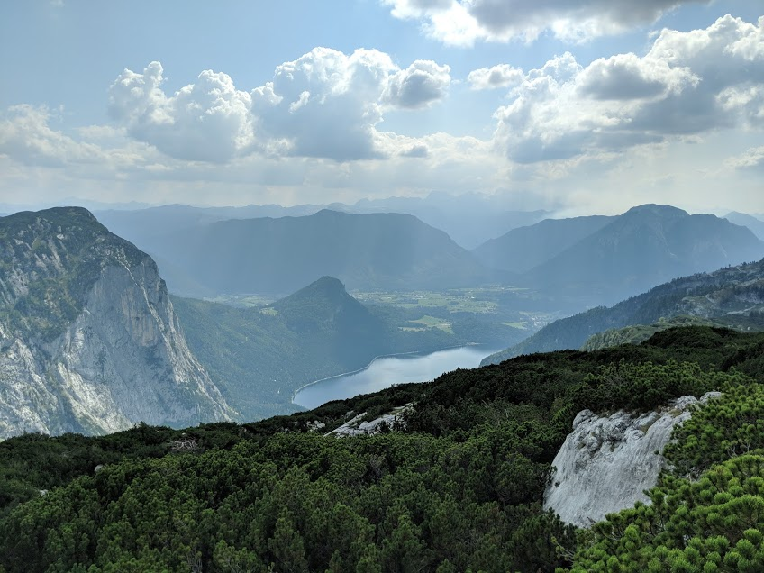
Cambridge University Caving Club
Expedition 2018
in the Loser Plateau and Schwarzmooskogel Hohlensystem
Ruairidh Macleod
(Not a picture of a cave…)

Slide 2
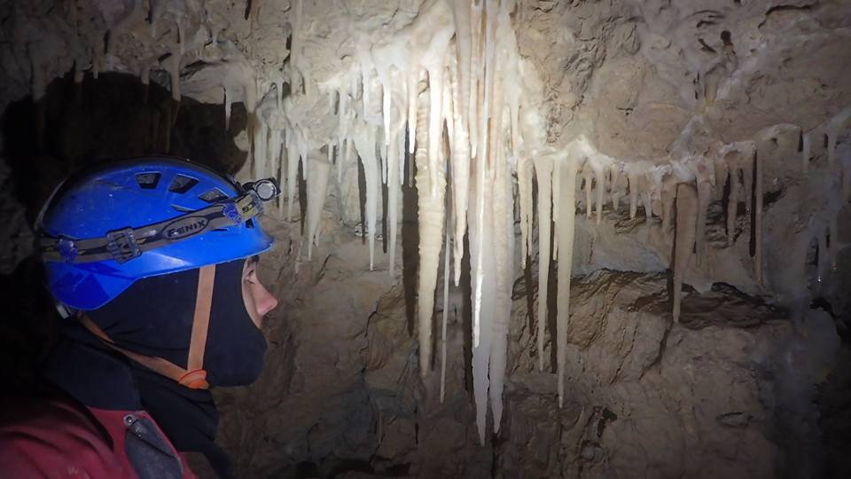
CUCC Expedition 2018
6 weeks: 7th July to 18th August
Training of new expedition cavers and survey software development
Continued extension and surveying of the Schwarzmooskogelhohlensystem
24 university student members
4 main caves focused on for new discovery
Surface survey and prospecting of new entrances on Loser Plateau
-
Mandatory picture of cave… Impressive formations in the new extensions of FischGesicht Hohle
Photo: Mike Butcher

Slide 3
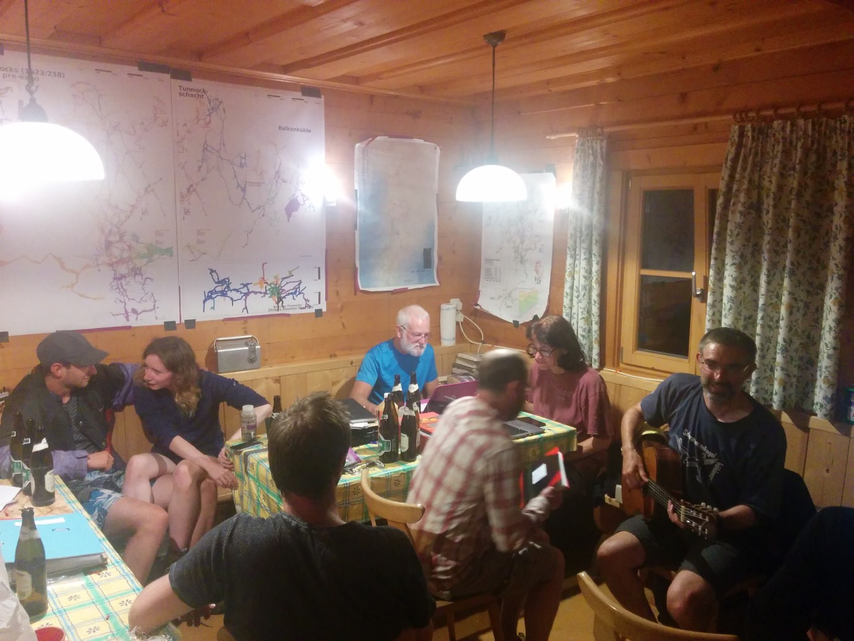
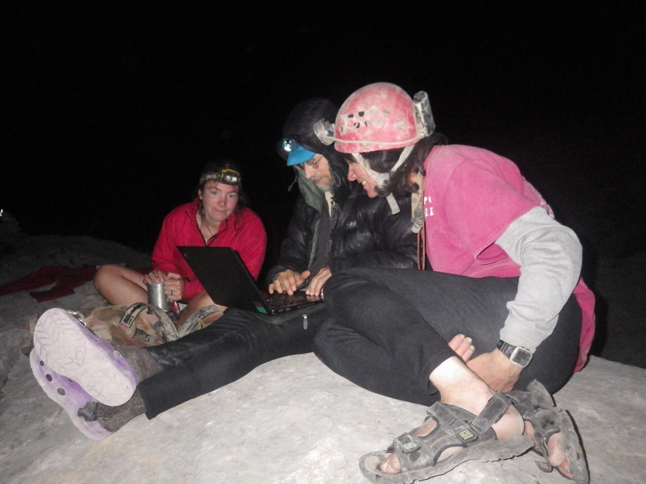
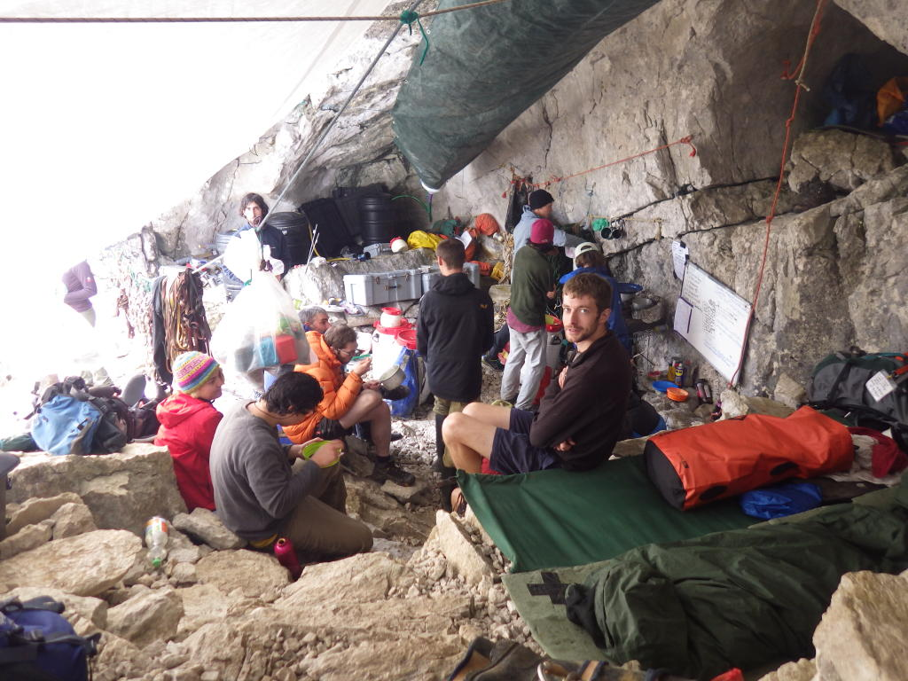
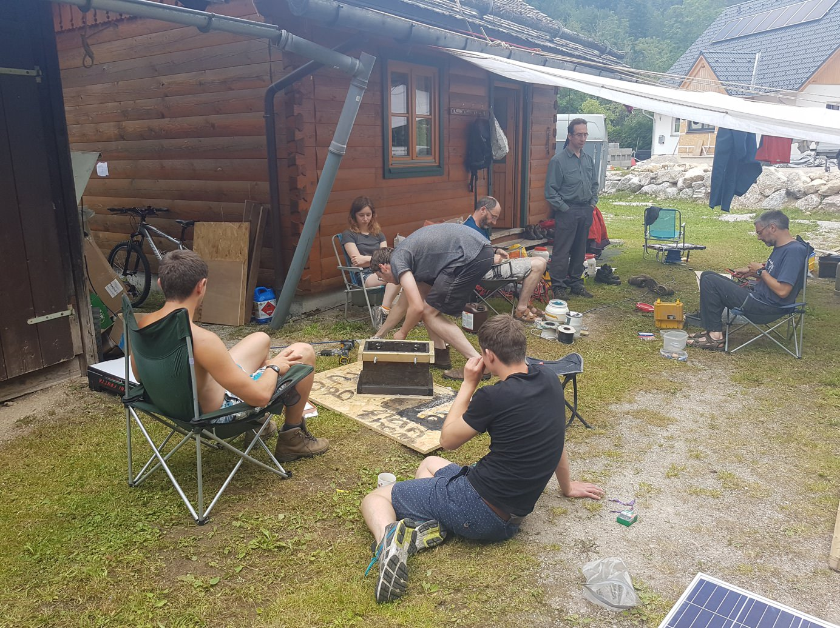
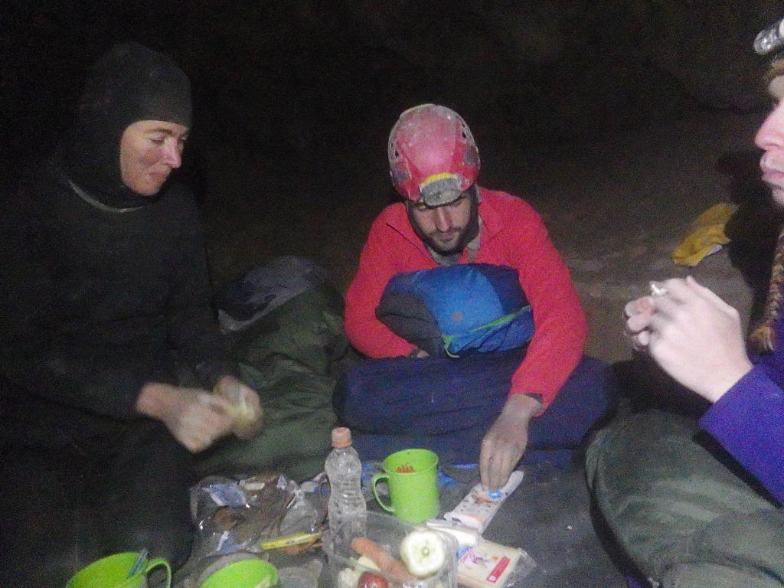
Photos: George Breley; Becka Lawson

Slide 4
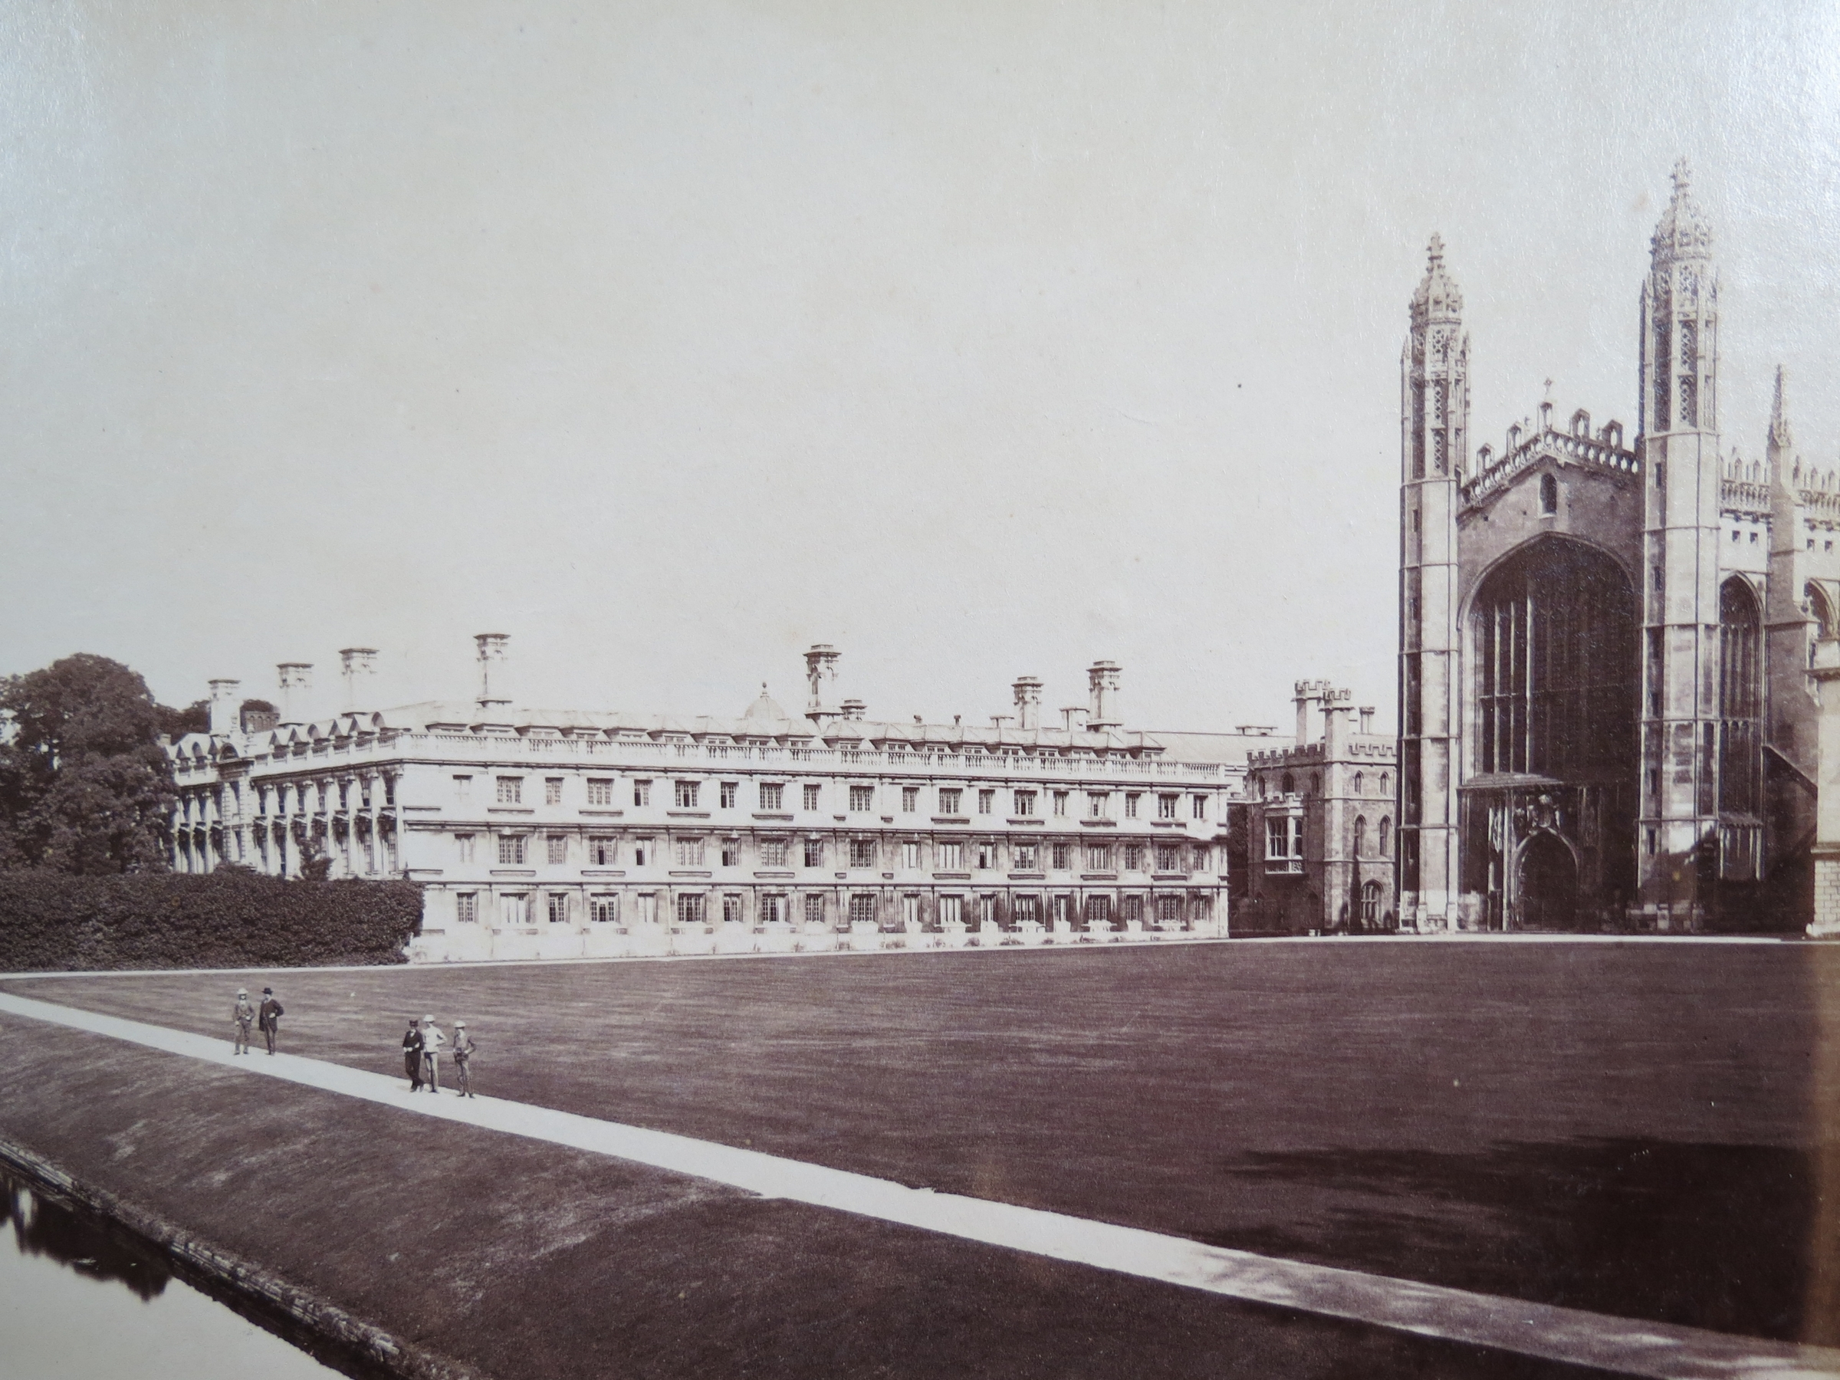
Photo: Wikimedia Commons

Slide 5
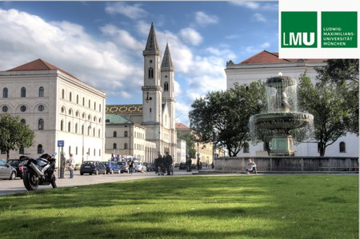
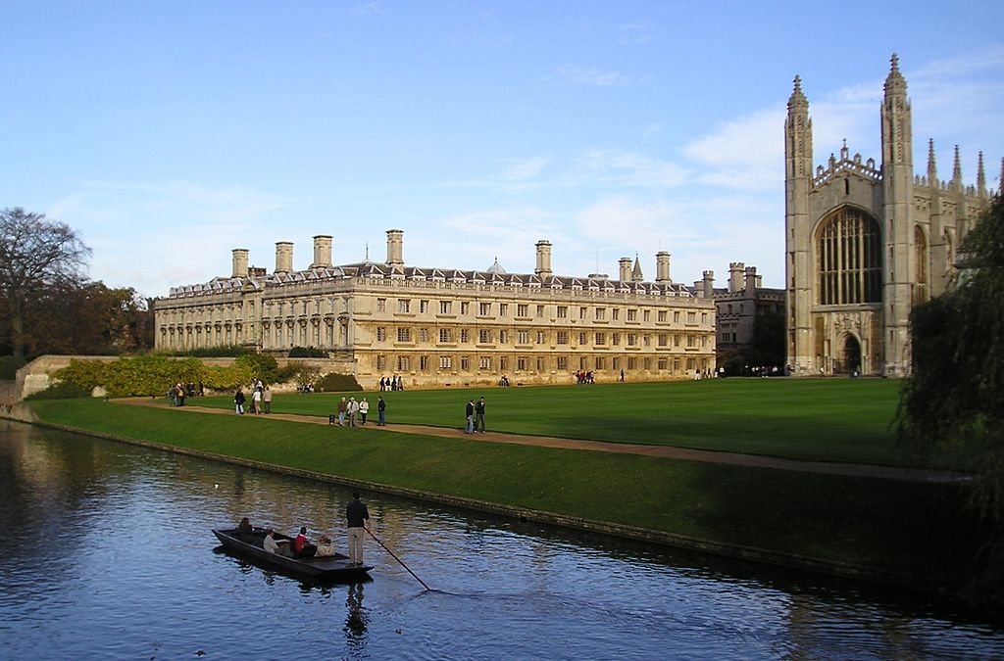
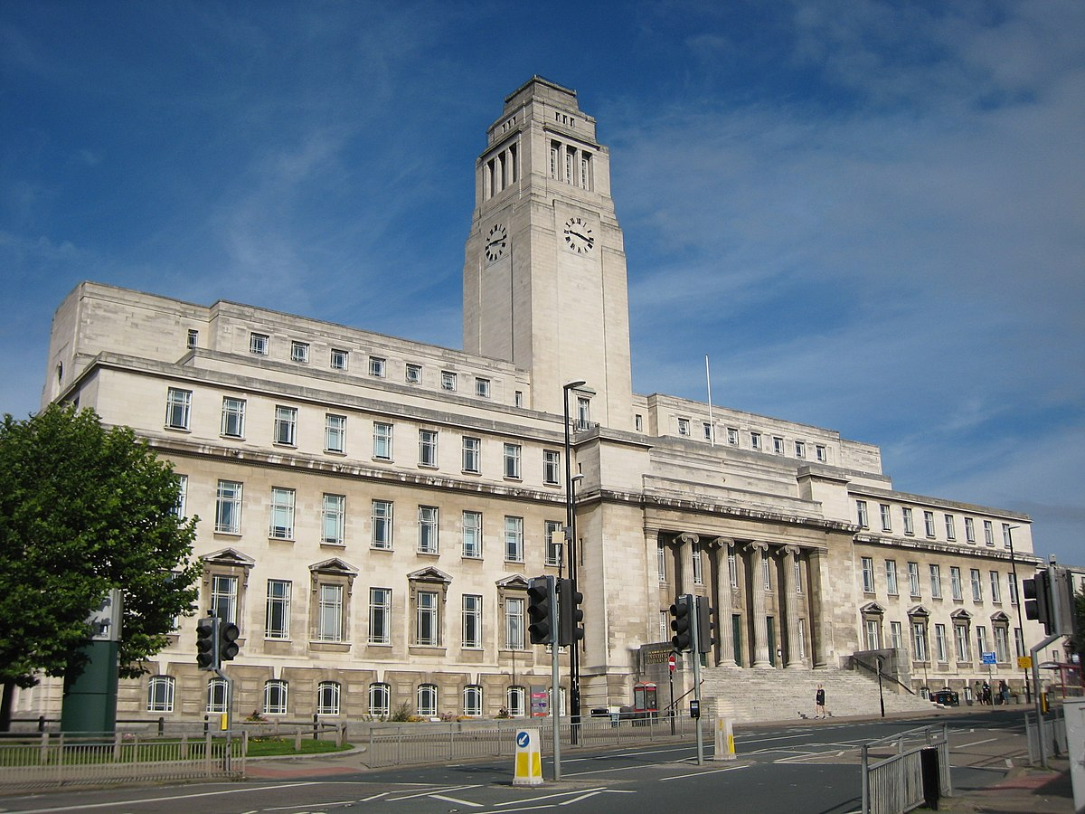
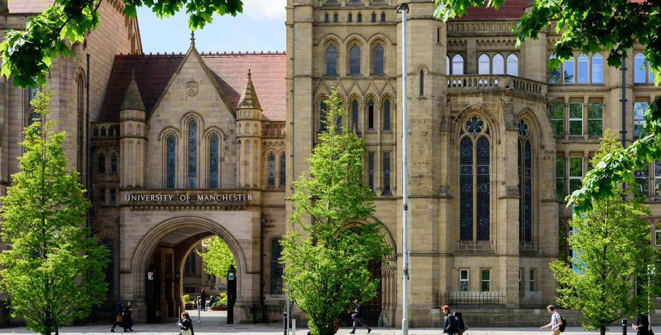
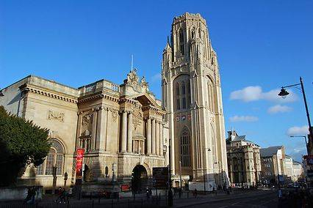
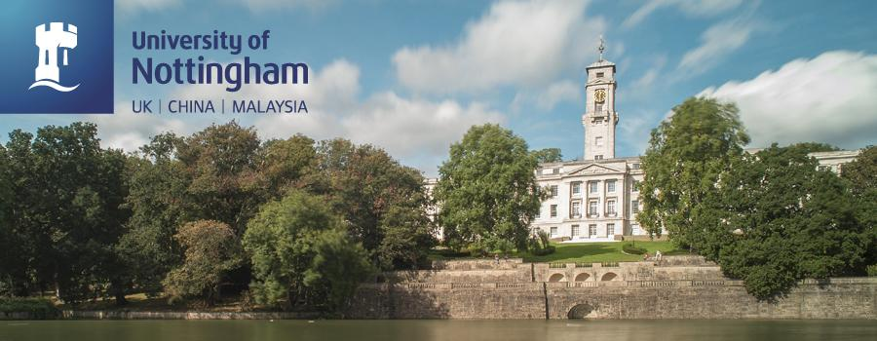

Slide 6
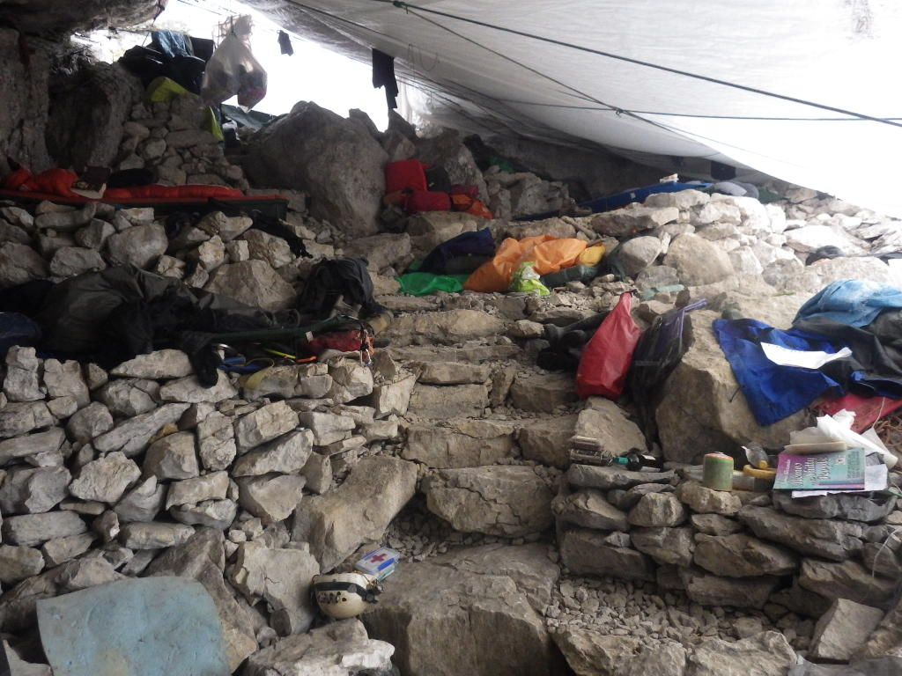
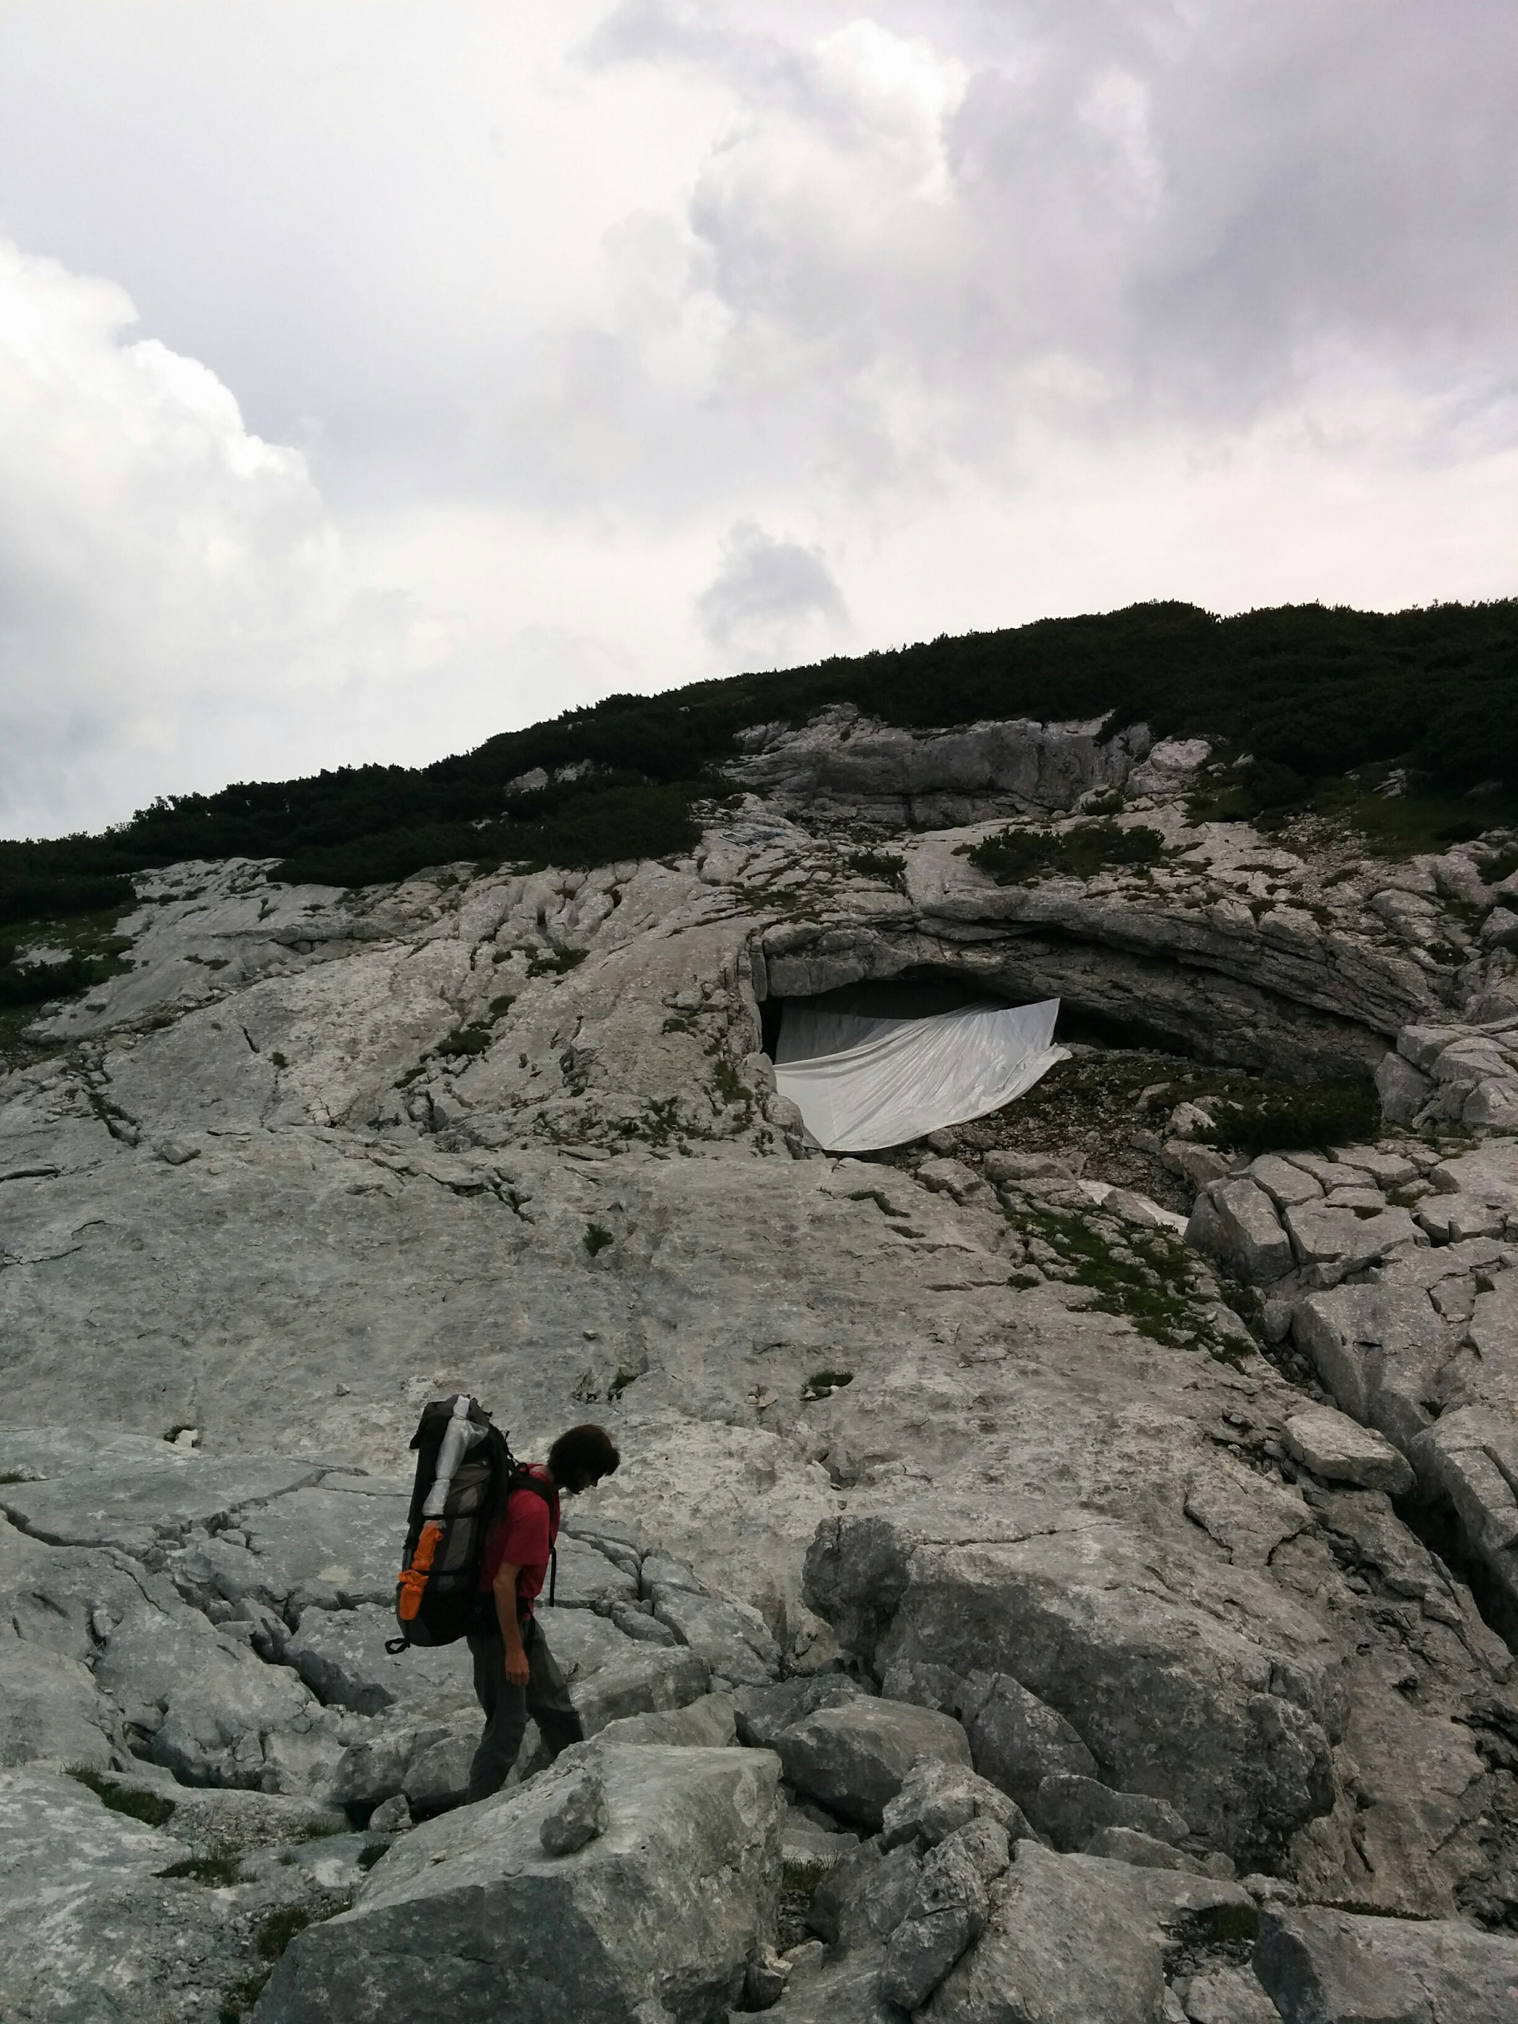
Stone Bridge Top Camp Bivvy on the Loser Plateau
Photos: Tom Crossley; George Breley

Slide 7
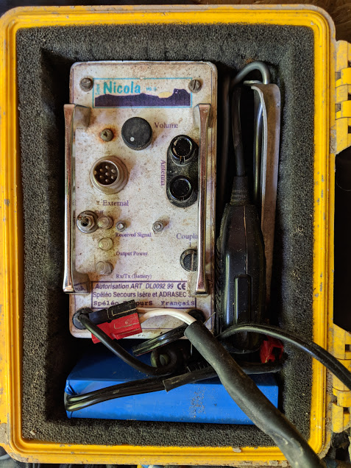
Electronic innovations for improving the expedition
Photos: Becka Lawson
Notes:
-solar power
-system Nicola

Slide 8
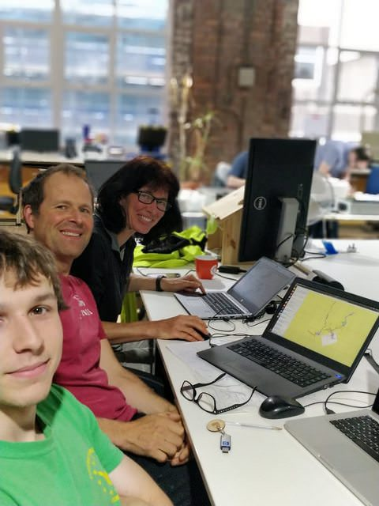
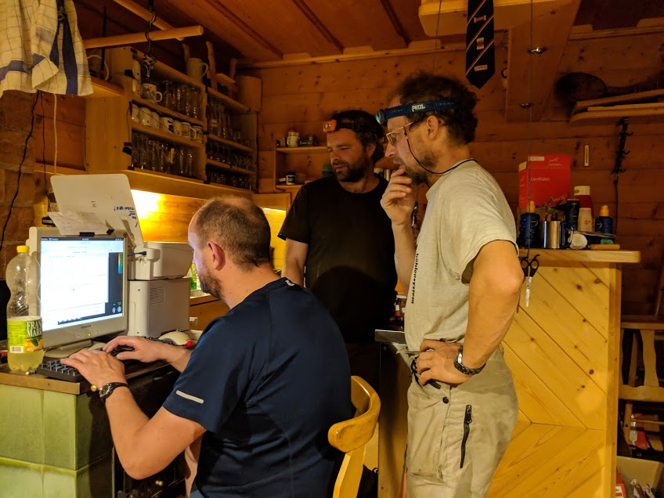
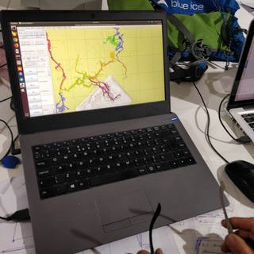
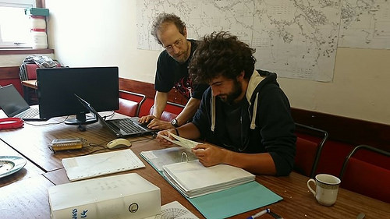
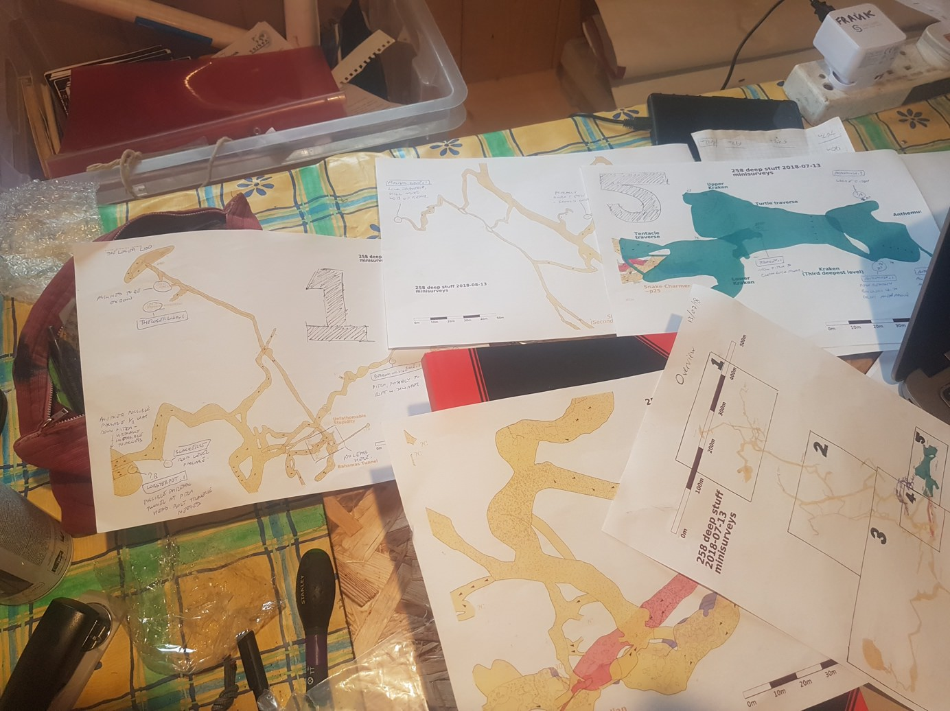
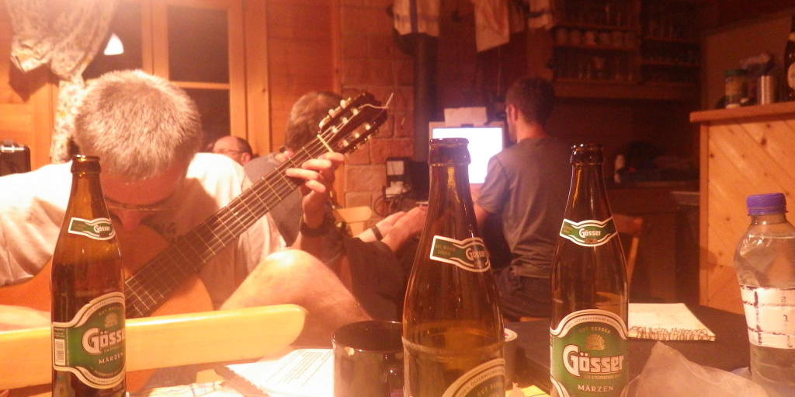
Digital survey data and GIS,
and general expedition “nerding”
Photos: Rob Watson; Becka Lawson; George Breley.

Slide 9
Google Maps

Slide 10
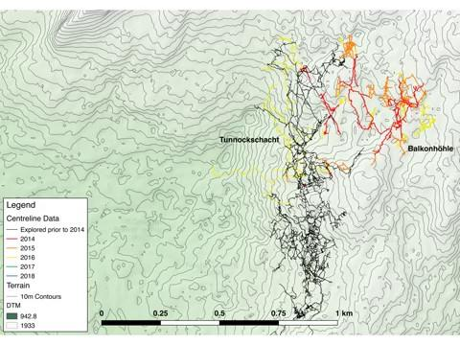

Slide 11
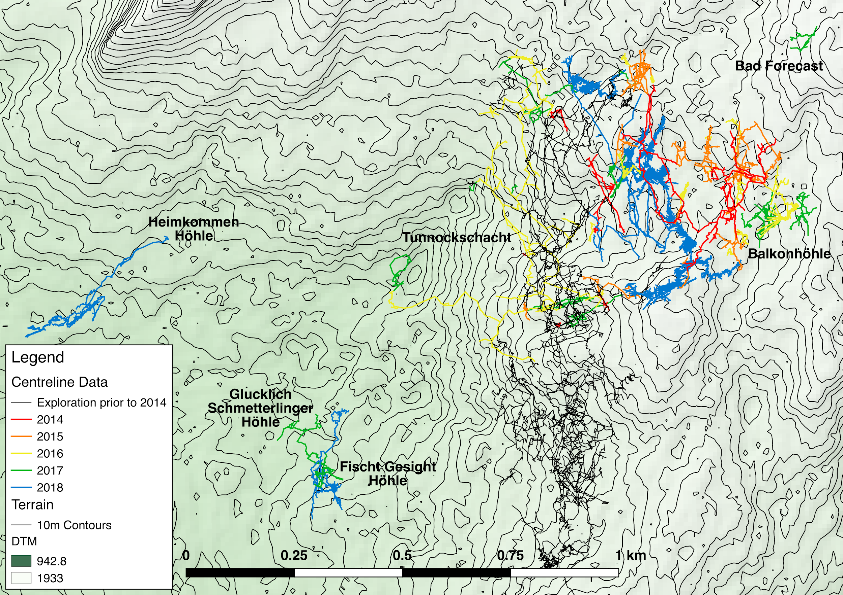

Slide 12
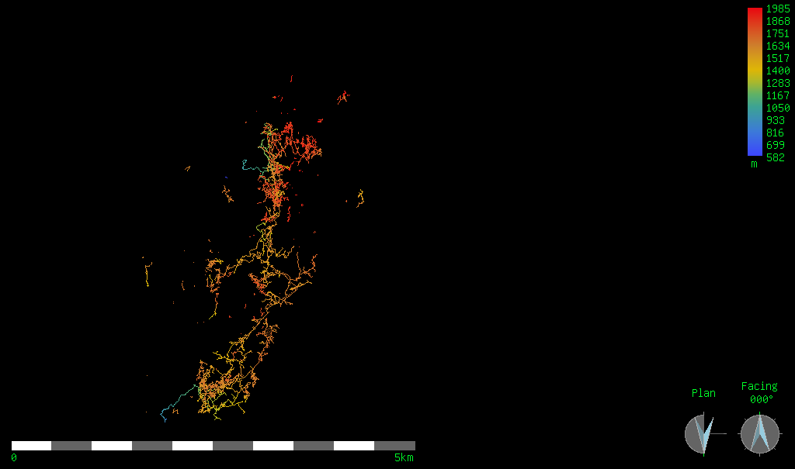
Extent of discovered cave in 2017 (plan)
2

Slide 13
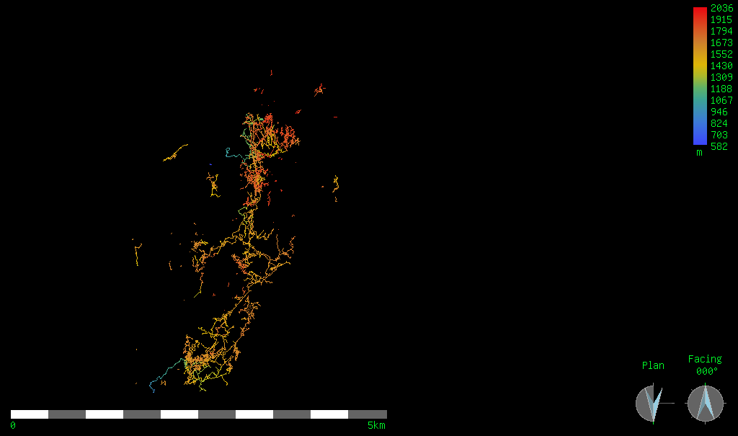
Extent of discovered cave in 2018 (plan)
2

Slide 14
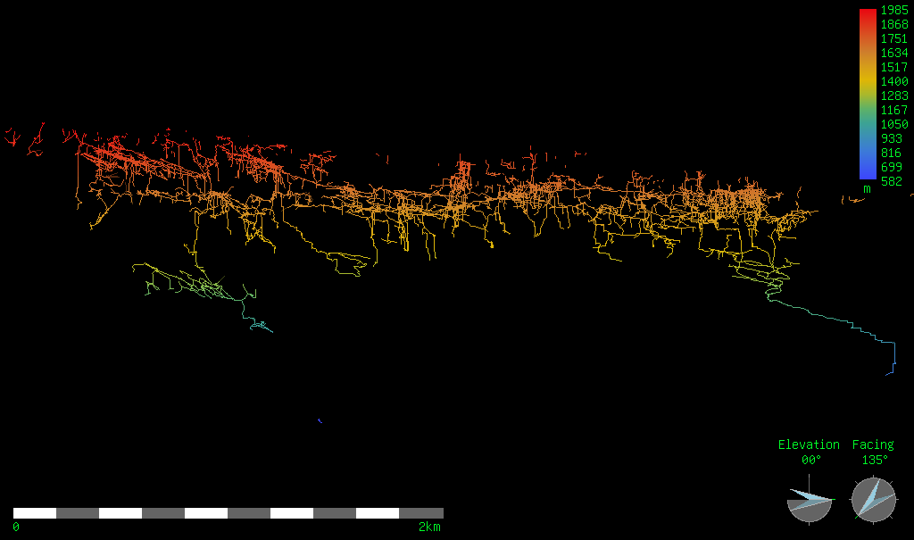
Extent of discovered cave in 2017 (elevation)
2

Slide 15
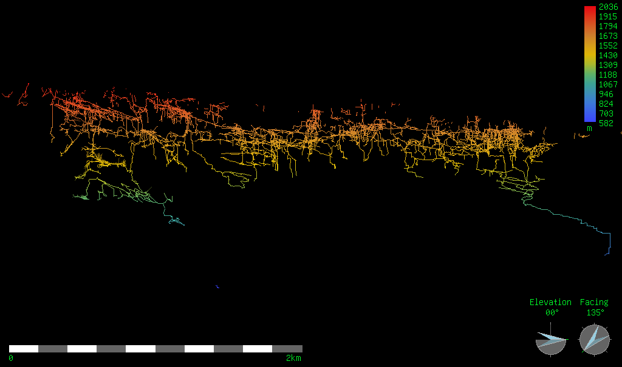
Extent of discovered cave in 2018 (elevation)
2

Slide 16
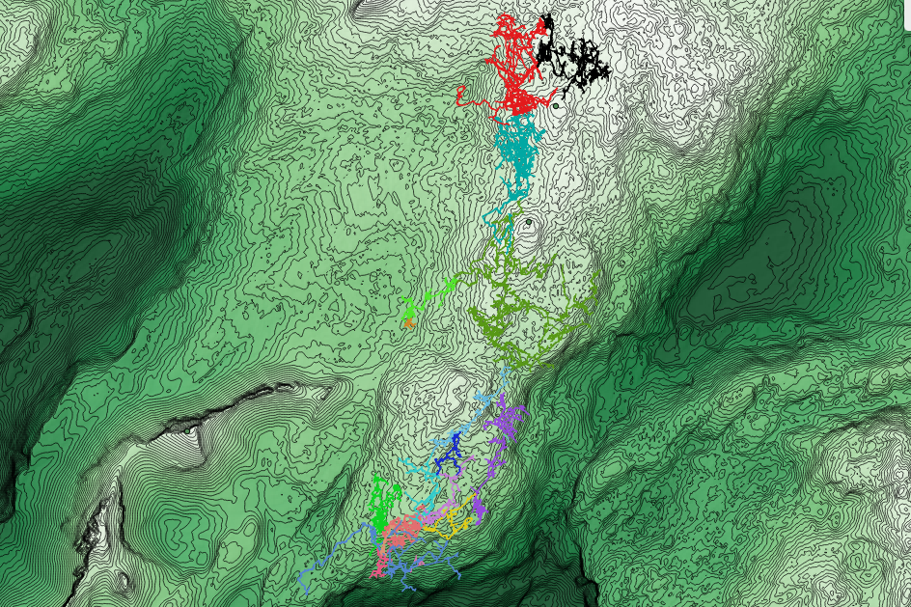
The SMK System as of 2018
Total processed survey length so far: 131.98km
New length from 2018 extensions: 5.7km
2
Notes:
SMK system: driving East

Slide 17
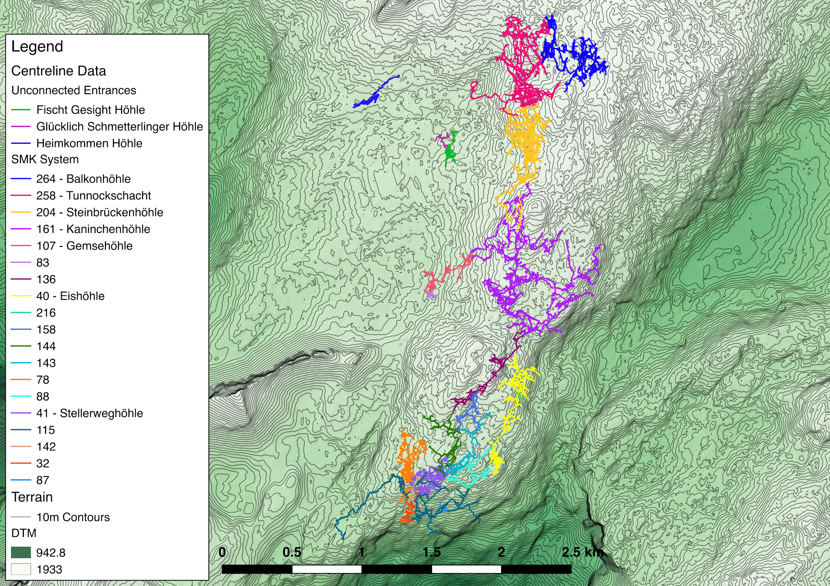

Slide 18
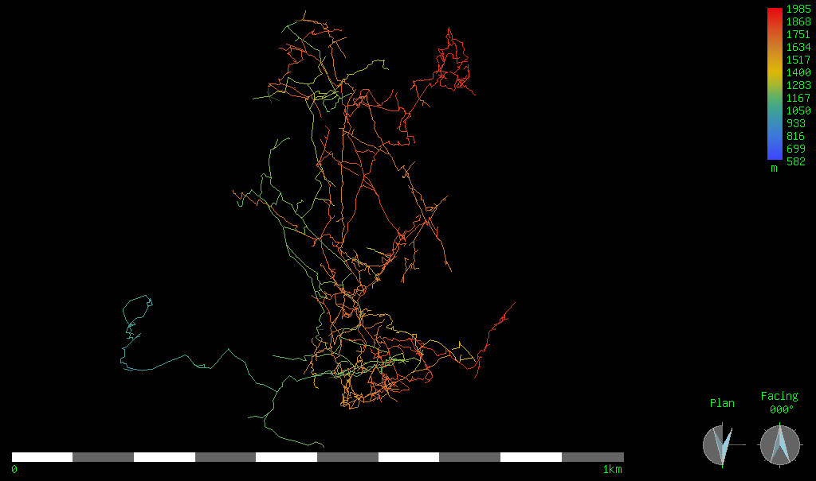
Extent of Tunnockschacht discovered in 2017 (plan)
2
Notes:
Tunnockschacht

Slide 19
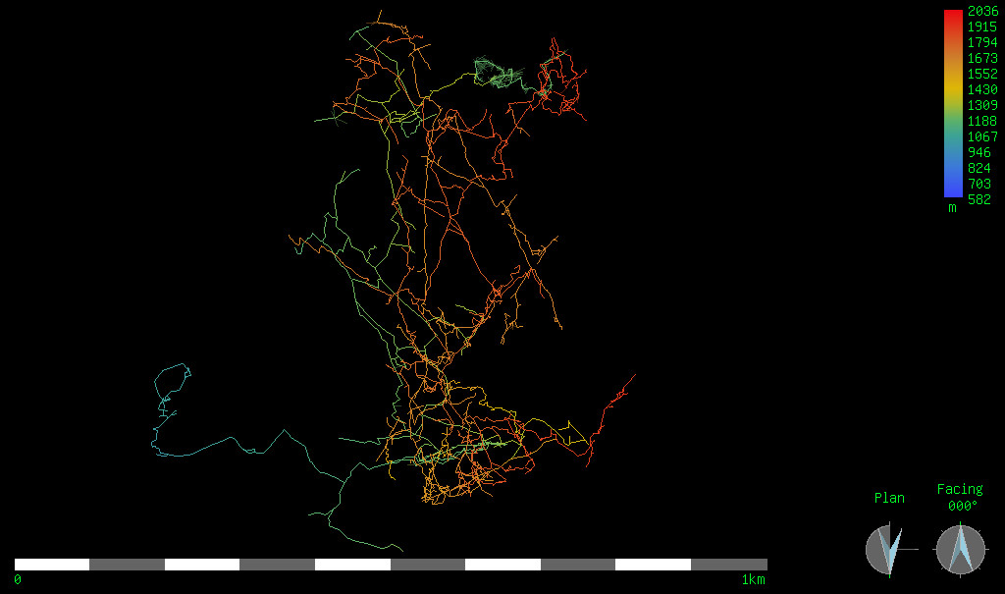
Extent of Tunnockschacht discovered in 2018 (plan)
2

Slide 20
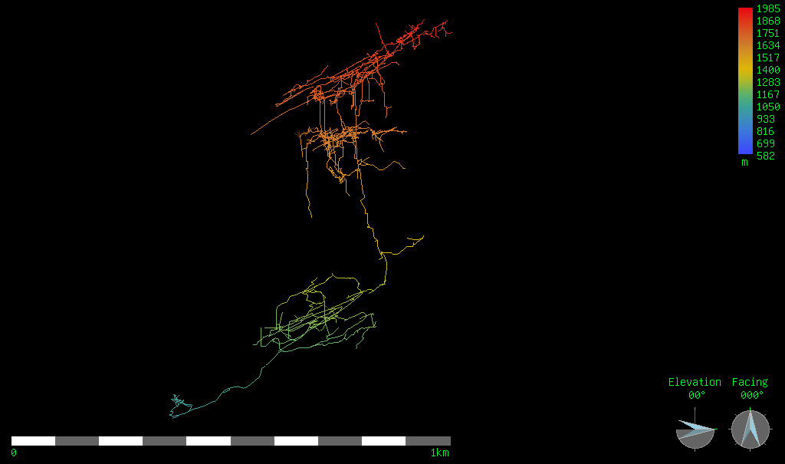
Extent of Tunnockschacht discovered in 2017 (elevation)
2

Slide 21
Extent of Tunnockschacht discovered in 2018 (elevation)
2

Slide 22
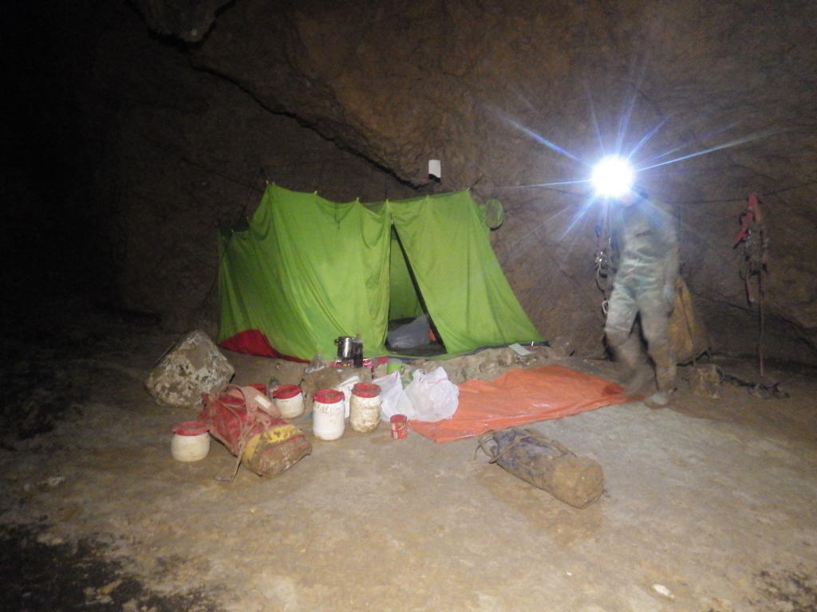

Slide 23
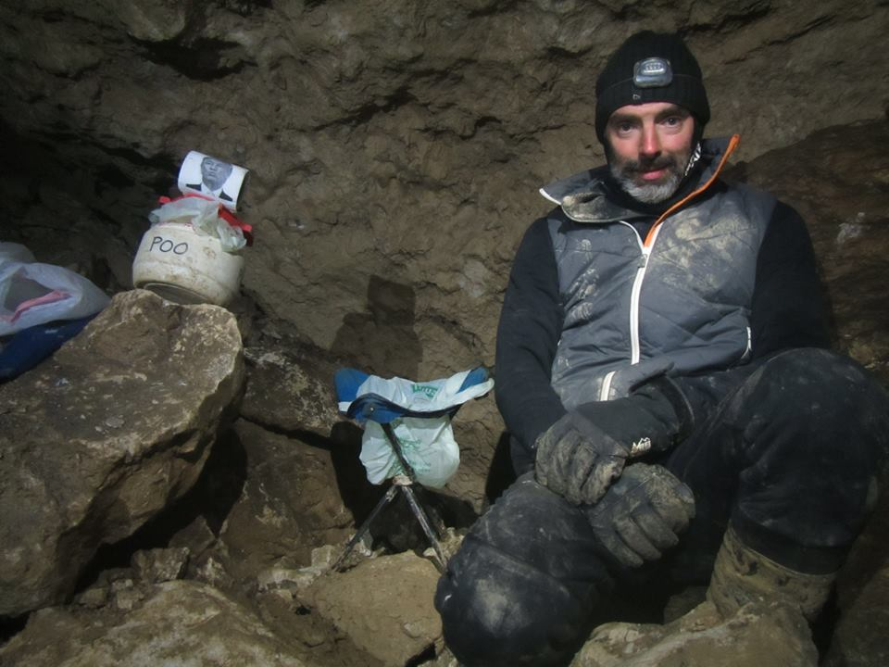

Slide 24
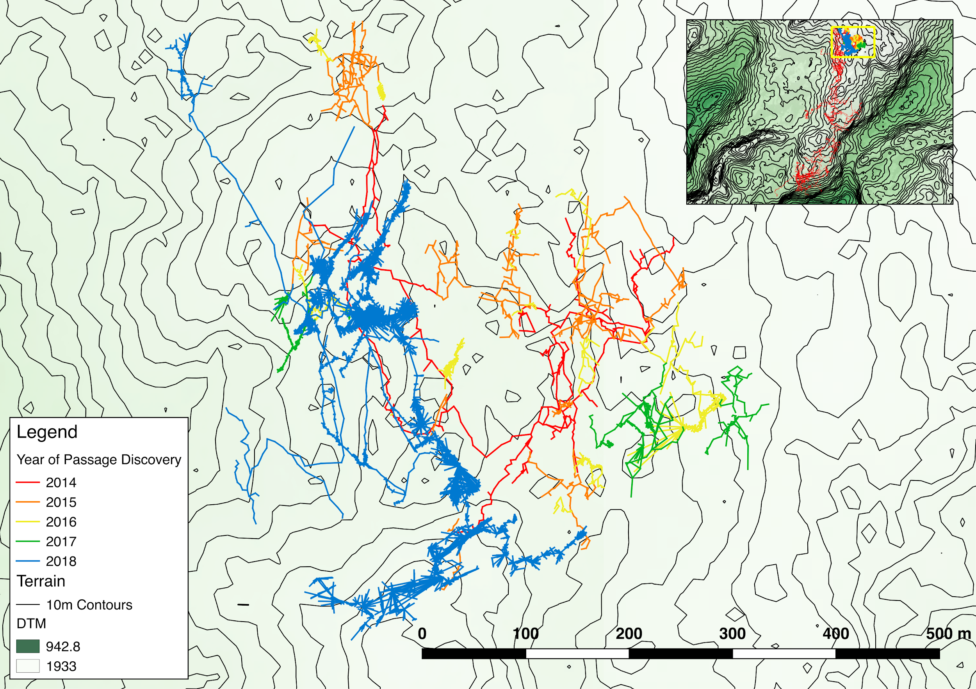

Slide 25
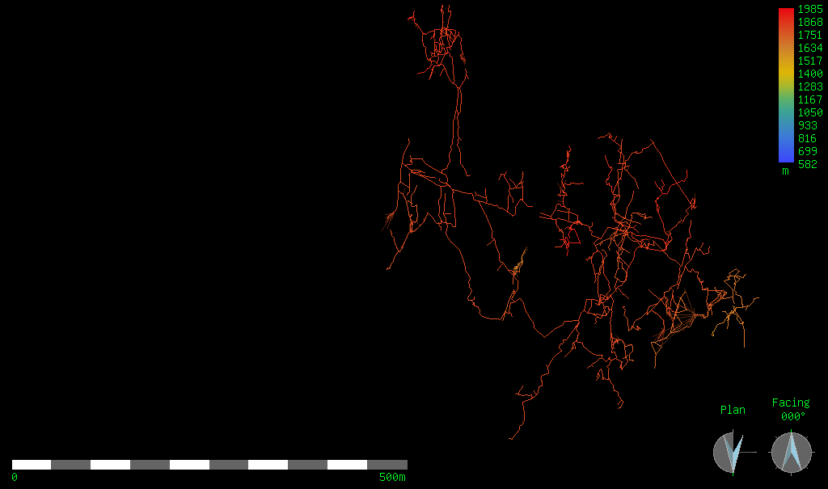
Extent of Balkonhohle discovered in 2017 (plan)
2

Slide 26
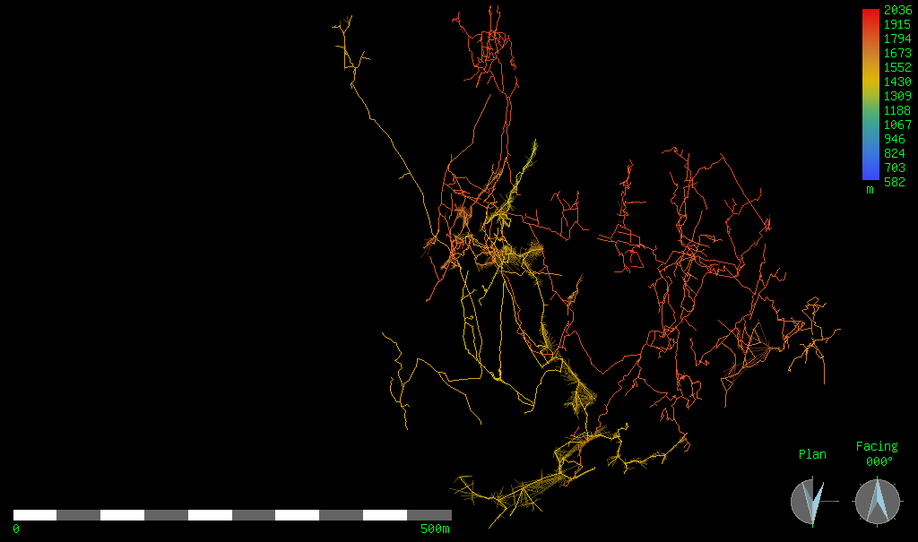
Extent of Balkonhohle discovered in 2018 (plan)
2

Slide 27
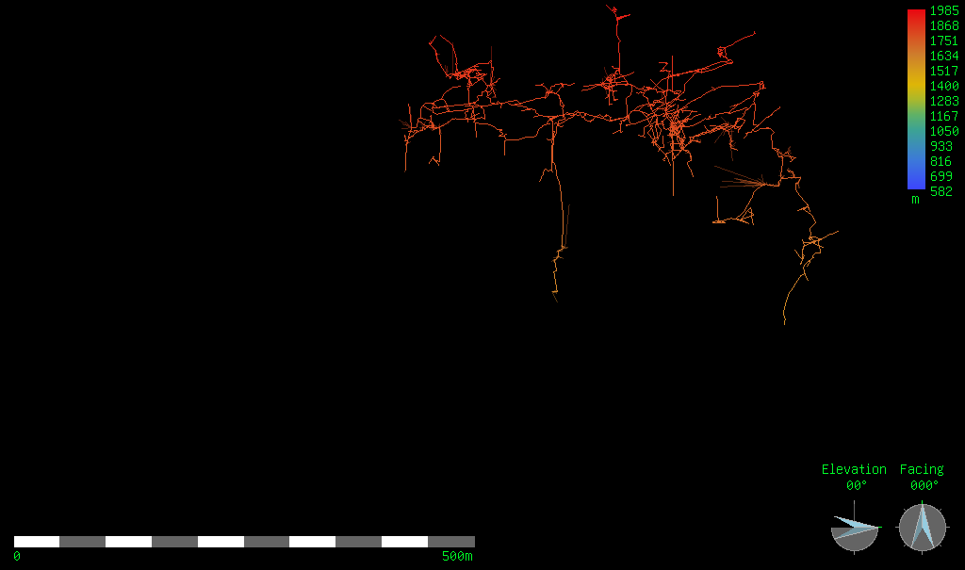
Extent of Balkonhohle discovered in 2017 (elevation)
2

Slide 28
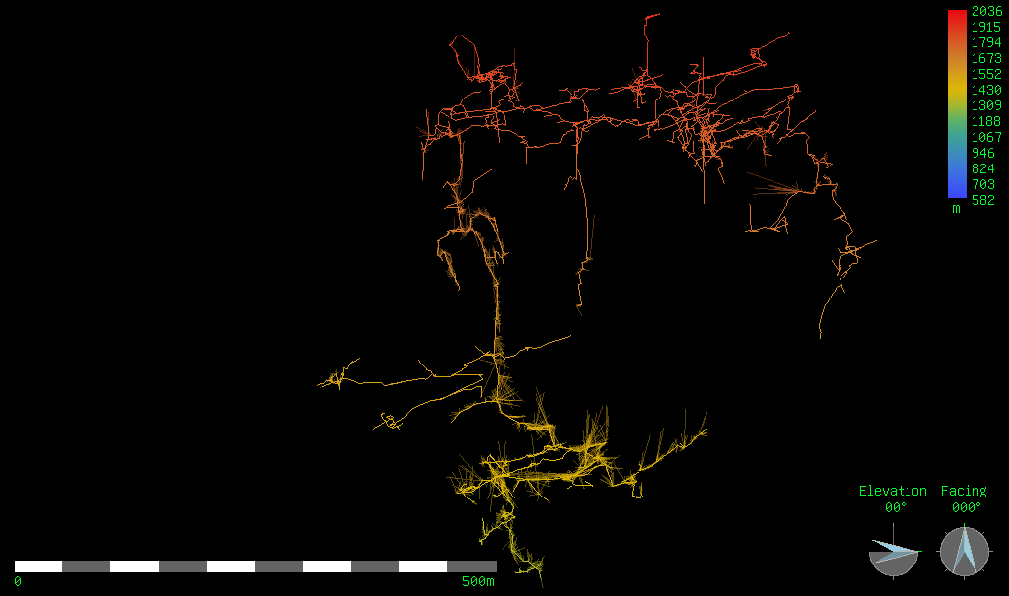
Extent of Balkonhohle discovered in 2018 (elevation)
2

Slide 29
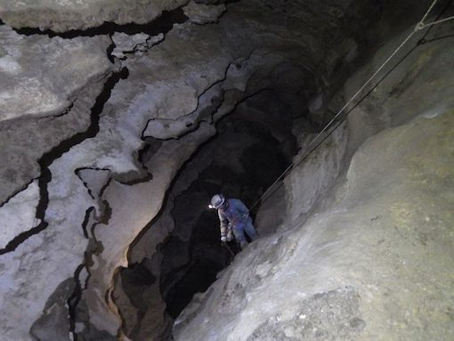
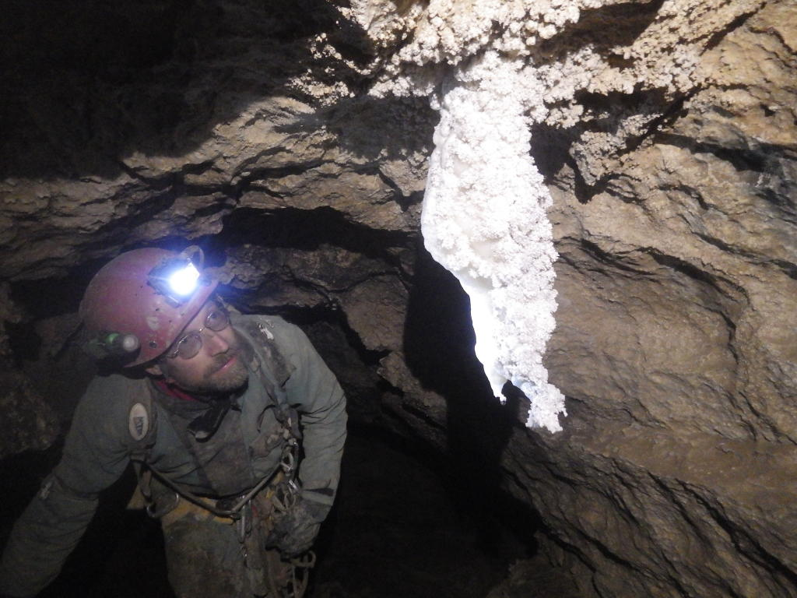

Slide 30
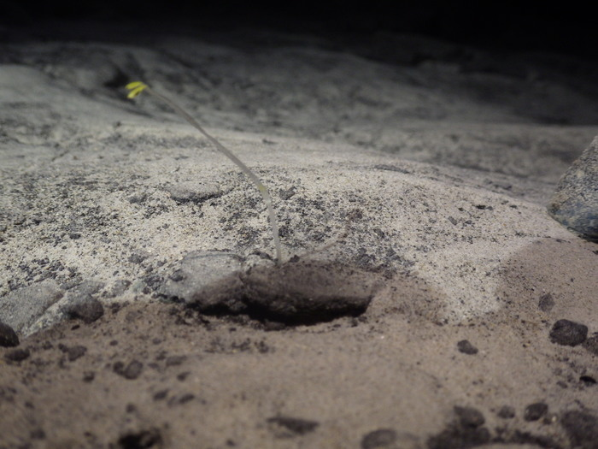
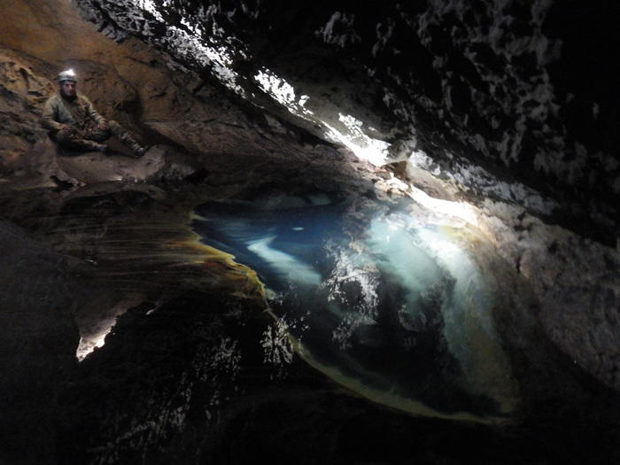

Slide 31
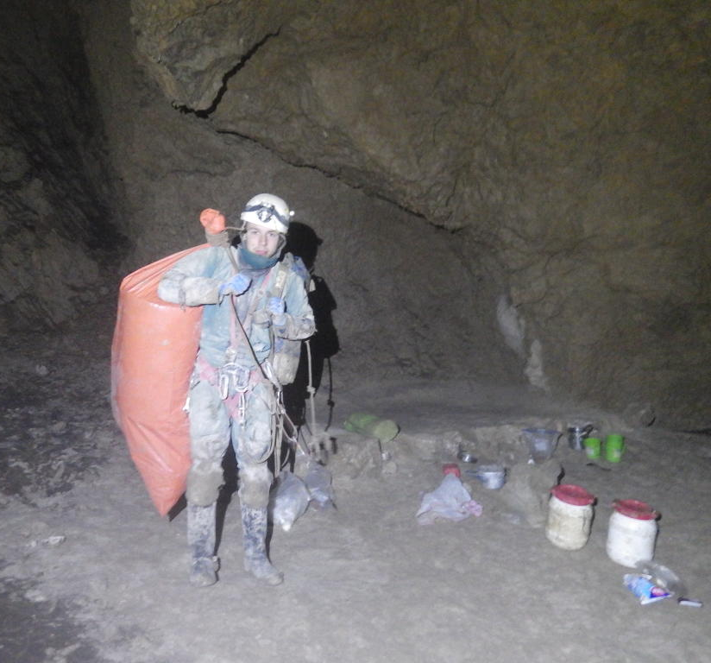
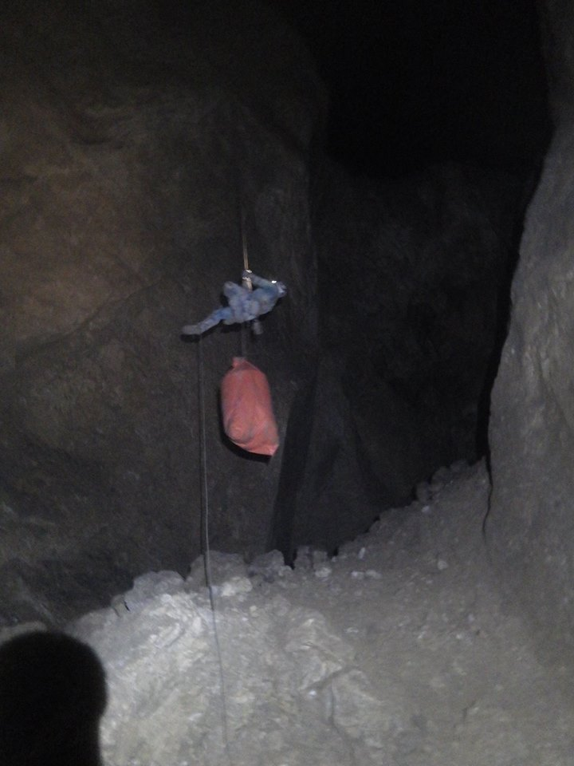
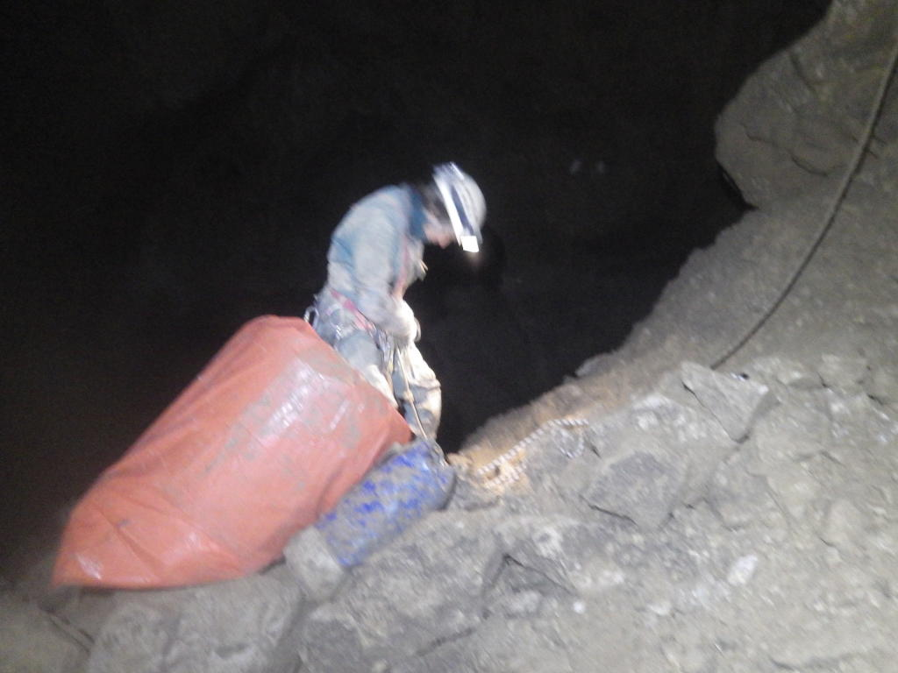

Slide 32
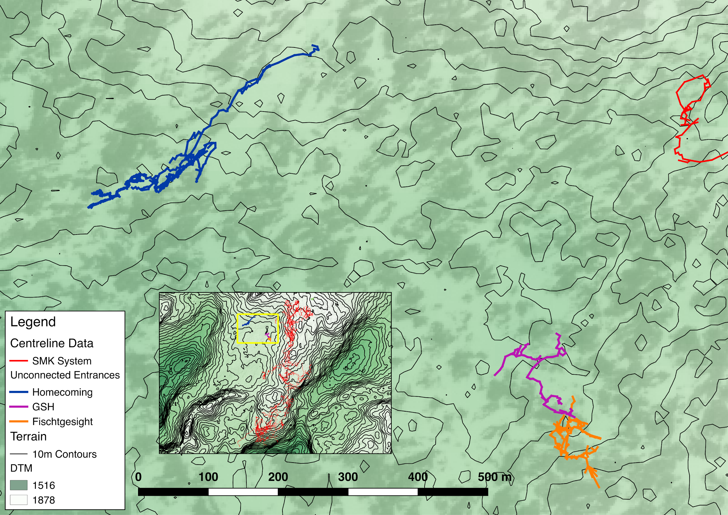

Slide 33
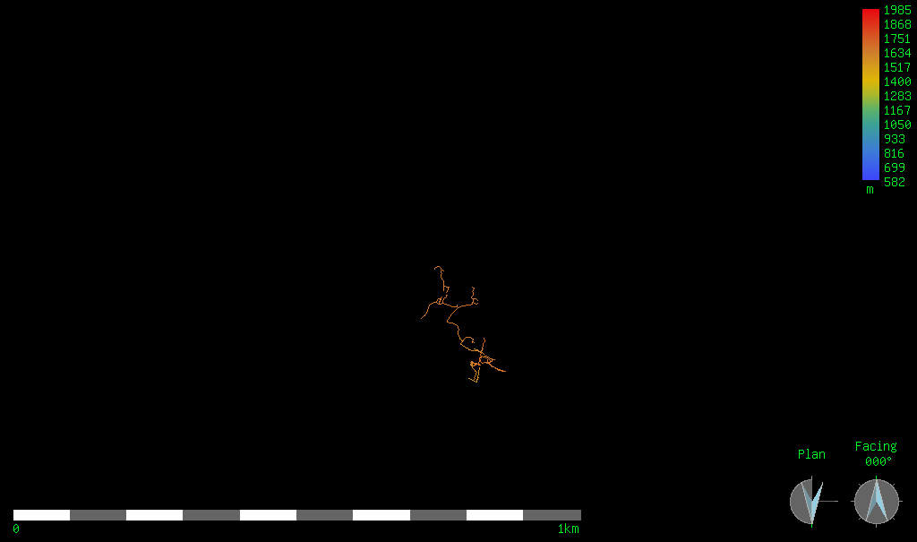
Extent of Homecoming and Fischgesicht discovered in 2017 (plan)
2

Slide 34
Extent of Homecoming and Fischgesicht discovered in 2018 (plan)
2

Slide 35
Extent of Homecoming and Fischgesicht discovered in 2017 (elevation)
2

Slide 36
Extent of Homecoming and Fischgesicht discovered in 2018 (elevation)
2

Slide 39
Photo: Rachel Turnbull

Slide 42
?

Slide 44
Thanks to:
Katey Bender, Martin Green and Wookey for assistance in maps and surveys
Haydon Saunders, Tom Crossley, Wookey, Rachel Turnbull, Rob Watson and Nadia Cherradi-Raeburn for help in organising the expedition
Expedition members: Adam Aldridge, Adam Henry, Adelaide de Diesbach, Alex Sterling, Anthony Day, Becka Lawson, Cat Henry, Chris Densham, Christopher Holt, Dickon Morris, Frank Tully, George Breley, Haydon Saunders, Jacob Puhalo-Smith, Jim Blackford, Jon Arne Toft, Julia Day, Lisa Smith, Luke Stangroom, Lydia Leather, Mark Shinwell, Max Weiser, Michael Holliday, Michael Sargent, Mike Butcher, Nadia Cherradi-Raeburn, Natalie Uomini, Olly Hall, Paul Fox, Phil Underwood, Philip Sargent, Philip Withnall, Rachel Turnbull, Radost Waszkiewicz, Ruairidh Macleod, Ryan Boultbee, Todd Rye, Tom Crossley, Typhon King and Wookey

Slide 45
Photo: Ruairiidh Macleod

Slide 46
Base Camp at Gasthof Staud’nwirt Potato Hut
Google Maps
Photos: Philip Sargent; Becka Lawson

